Slide 1
Wireless Mesh Networking
Progress, Status, and Database

Slide 2
Current Project
Goals:
Creation of a system to collect and store network metrics in real-time.
Synchronization of several individual instances of data collection.
Categorization of data for display and analysis.
Accessing data from a single database or UI.
Status:
Real-time collection, parsing, tagging, and storing of a command on a local database.
Database connected to a graphing tool for visualization.
We have the end-to-end product, but only on individual nodes.

Slide 3
InfluxDB
What it is:
Open-source, time-series database
Specifically designed to handle time-stamped data.
Popular in applications where the time-element is a priority.
Why it’s useful:
Time-series database are ideal for collecting large amounts of time-stamped data.
More efficient than other database types for handling large volumes of data where the time-element is prioritized.
An active community with a rich ecosystem of tools and integration (such as Grafana, Kapacitor, Chronograf, Telegraf).
Uses an InfluxQL (SQL-like) query language for data access.

Slide 4
InfluxDB: Mechanics
High write and query performance.
Optimized storage formats (such as Time-Structured Merge) to reduce disk I/O.
Database leverages its natural chronological order to index without additional complex indexing structures.
Time-centric indexing is ideal for range-based querying, a common process when using time-based data.
Data compression methods (Run Length & Delta-to-Delta) on repetitive data-sets to reduce write size.
Flexible schema design.
The tagging metadata improves data organization and description.
Field-value pairs allow for diverse data types in the same measurement, without schema modifications
Dynamic tag and field sets allows for the schema to evolve.
Notes:
TSM is a storage engine designed by InfluxDB to handle time-series data (sequential writes, encoding, compaction, indexing, data partitioning)

Slide 5
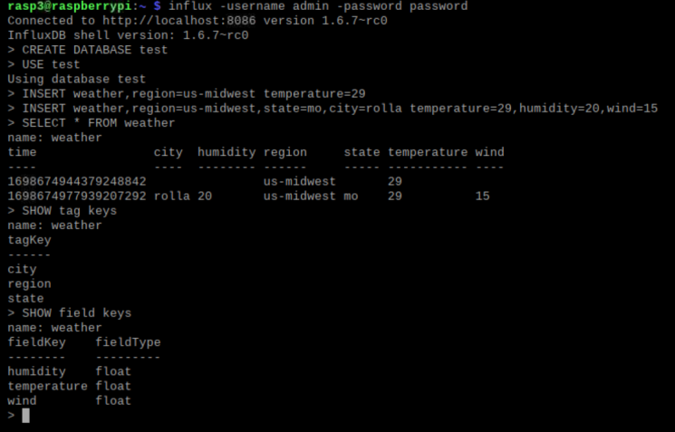
InfluxDB: How it’s used
An SQL-like query language is provided to create, modify, query, and manipulate databases.
Uses a line-protocol to assign custom keys and values to data points:
(measurement),(tag_set) (field_set), (timestamp)
Allow users to query data:
Within local InfluxDB -> databases
Within database -> measurements.
Within measurements -> tags, fields, and values.
Within values -> different ranges.
In the context of WMNs:
Database: indoorTesting
Measurements: interferanceTest
Tag keys: state of controlled variables (path, interference), test iteration
Field keys: throughput, latency, packet loss

Slide 6
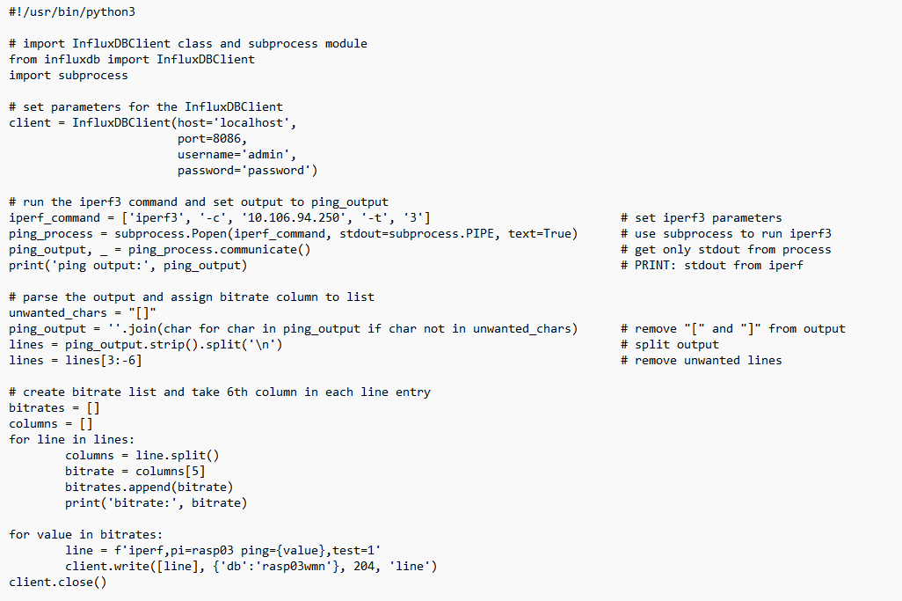
InfluxDB: How it’s used
Import the InfluxDBClient class and Python subprocess module
Set parameters for InfluxDB
Run the iPerf3 ping as a subprocess
Parse the textual output for the ping value
Format the line protocol with measurements, tags, and fields.
Use client.write() to send the line to the database

Slide 7
Future Tasks
Develop a tagging system
Expanding data collection to new metrics.
Linking databases or consolidating data.
Explore InfluxData tools
Script1
Script2
Telegraf
Kapacitor
Script1
InfluxDB
InfluxDB
Script2
Telegraf
.csv
InfluxDB
Grafana
Chronograf

